Slide 1
Context Aware Test Case Generator
AI-Powered Test Case Generation System
Prepared by: Rockers
[Ashish Tripathi, Md. Sharjeel Haider]

Slide 2
Agenda
Project Overview
System Architecture
Backend Implementation
Frontend Implementation
Key Features
Demo
Future Enhancements

Slide 3
Project Overview
Objective: Automate payment system test case generation using OpenAI
Technology Stack:
Backend: Java/Spring Boot
Frontend: Angular
AI: OpenAI API
Benefits:
Saves manual effort
Covers edge cases
Consistent test case format

Slide 4
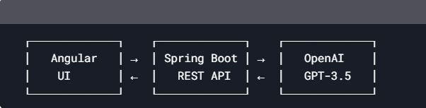
System Architecture Diagram
Frontend: Angular 15+ with Material UI
Backend: Spring Boot 3.1 (Java 17)
Integration: OpenAI API with OkHttp

Slide 5
Backend Implementation
Key Components:
OpenAIService.java: Handles OpenAI API integration
TestGenController.java: REST API endpoints
Dependencies:
Spring Boot Web
OkHttp
Jackson
Configuration:
YAML-based properties
Swagger for API docs

Slide 6
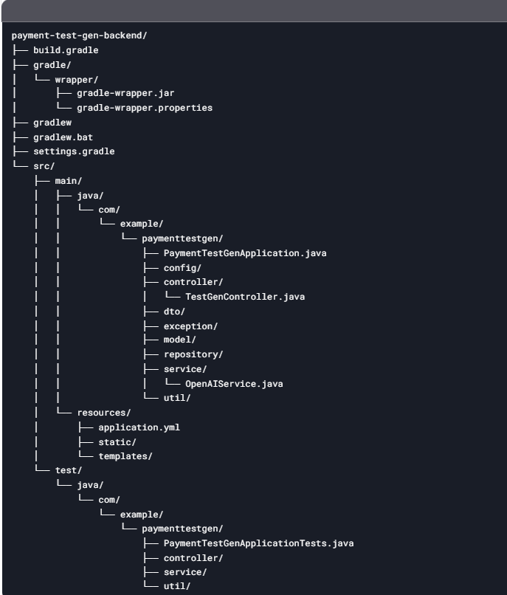
Backend (Spring Boot) Project Structure

Slide 7
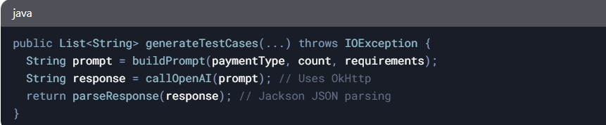
Code Snippet (OpenAIService.java):
Key Features: ✔️ Rate limiting ✔️ JSON payload construction ✔️ Error handling for API failures

Slide 8
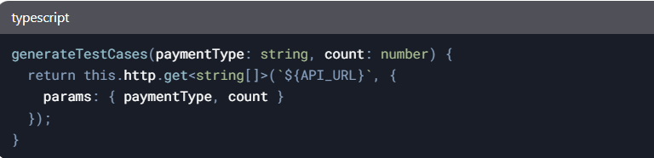
Frontend Highlights
Code Highlight (test-case.service.ts):
Key Features: ✔️ Payment type dropdown
✔️ Test case count slider
✔️ Requirements textarea

Slide 9
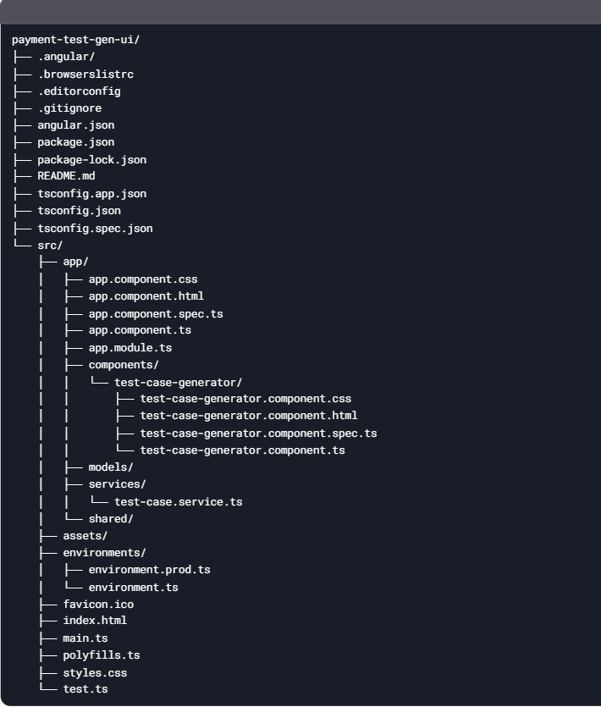
Frontend (Angular) Project Structure

Slide 10
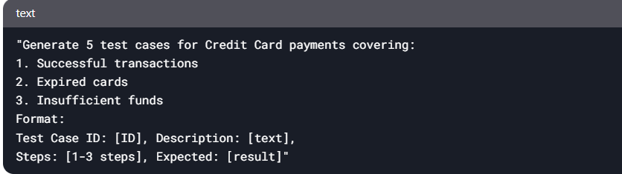
OpenAI Integration
Prompt Engineering Example:
Response Handling:
Parses JSON with Jackson
Extracts content from choices[0].message.content

Slide 11
Future Roadmap
Export as PDF
Jira Integration
Multi-model support (GPT-4)
Self-learning test bank

